Slide 1
WNBA Draft prediction model

Slide 2
AGENDA
Motivation/Problem
Business Aspect
Column Descriptions
Missing Data
Key Features/Feature Engineering
Correlation/Outliers
Other Model Evaluations
Final List
Comparison of each Player
Complications/Resolutions

Slide 3
Motivation/Problem
The WNBA receives significantly less media coverage and attention than the NBA, limiting its visibility and growth
Top prospects often lack early-career exposure, reducing fan excitement around the draft process
Outside factors in the drafting process (team needs and GM evaluations) create unpredictability in draft predictions
A lack of WNBA specific metrics makes accurate draft predictions more difficult

Slide 4
Business Aspect
Our WNBA Draft Prediction Model can increase league revenue by boosting fan engagement and media attention
Enhanced visibility for lesser-known prospects can open new opportunities for more sponsors and marketing opportunities
The media and WNBA itself can use prediction insights to create content and boost excitement for the draft
Team owners, sponsors, and fans benefit from improved storylines around draft outcomes

Slide 5
Column Descriptions
Column Name | Dataset | Data Type | Description
overall_pick | wnbadraft | int64 | The sequence in which the athletes are selected
year | wnbadraft | int64 | The draft year
team | wnbadraft | object | The team the player is being drafted into
player | Both | object | Player’s name
college/former | Both | object | College indicates US player and Former; international player
position | Both | object | The position the player plays
height | Both | object | The height of player
years_played | wnbadraft | int64 | Career length after draft
games | Both | float64 | The number of games played
minutes_played | Both | float64 | The amount of time a player is on the court per game/season
points | Both | float64 | The amount of points a player averaged a season
total_rebounds | Both | float64 | The amount of rebounds the player averaged a season
win_shares | Both | float64 | A player's contribution to the team’s win
win_shares_40 | Both | float64 | A player’s contribution to the team’s win in a 40-minute game

Slide 6
Column Descriptions
Column Name | Dataset | Data Type | Description
assists | Both | float64 | A pass that leads to a point
spg | Both | float64 | The amount of steals the player is averaging per game
bpg | Both | float64 | The amount of blocks the player is averaging per game
fg% | Both | object | A player's shooting accuracy
3-fg% | Both | object | A player’s accuracy on the 3-point line
ft% | Both | object | A player’s rate of making a free throw from the foul line
birth year | college_prospects | float64 | The year the player was born
to | college_prospects | float64 | The number of turnovers the player is averaging
PER | college_prospects | object | The player’s efficiency rate
box_efficiency | college_prospects | object | The player’s box plus/minus (contribution to the team per 100 possessions)
national champion | college_prospects | int64 | If the player won a National Championship
overall points | college_prospects | float64 | The player’s award points
team_win % | college_prospects | object | The team’s win score (calculated by games won and games played

Slide 7
Missing Data
If any performance stats were missing (games, assists) = filled with a 0
If any shooting stats were missing (fg%, 3-fg%) = filled with a 0
If any biographical columns were missing
Object dtype (position) = filled with mode
Numeric (height) = filled with median
Categorical columns <5% missing = mode unless 5-20% = Missing, if >20% = skip
Performance columns are preserved because nulls or zeroes carry meaning
0’s are important because:
The data never occurred (player never played in a pro game)
Consistency with shooting stats (player had no attempts = 0%)
Model signals (no pro experience doesn’t mean fill it with the median)

Slide 8
Key Features/Feature Engineering
Feature Engineering
award_points: Numeric score from awards/honors
college_points:Numeric score for school quality
mid_major_flag: Binary indicating mid-major programs
points_mid_adj: Points docked/adjusted for mid-major status
ts_pct: True shooting percentage (points, FGA, FTA)
turnover_to_assist: Turnover to assist ratio (tov/(ast + eps)
draft_success: Binary indicator if a player ever played pro
high_draft_pick_indicator: Binary indicator for first-round picks
overall_pick_standardized: Reversed draft pick so higher = better pick
year_since_draft: Numeric (current_year – year)
Key Features
points
total_rebounds
games
win_shares
assists

Slide 9
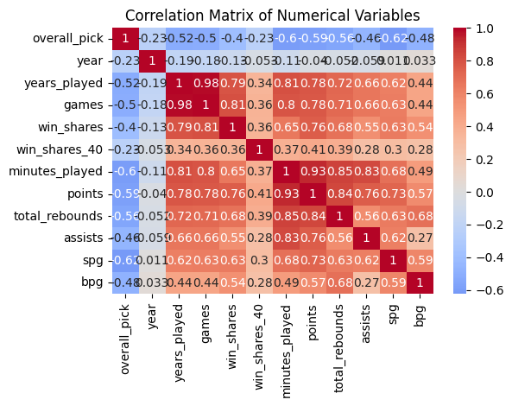
Correlation/Outliers
Our model ranked raw performance stats highly (points, games, and assists) so they are highly correlated
Random Forest works fine with correlated predictors (can produce good predictive performances)
We created variants for several performance columns and preserved NaNs for performance stats, so outlier rules were applied to non-null performance stats
Checked missingness correlations; was intentionally preserved because it can be informative

Slide 10
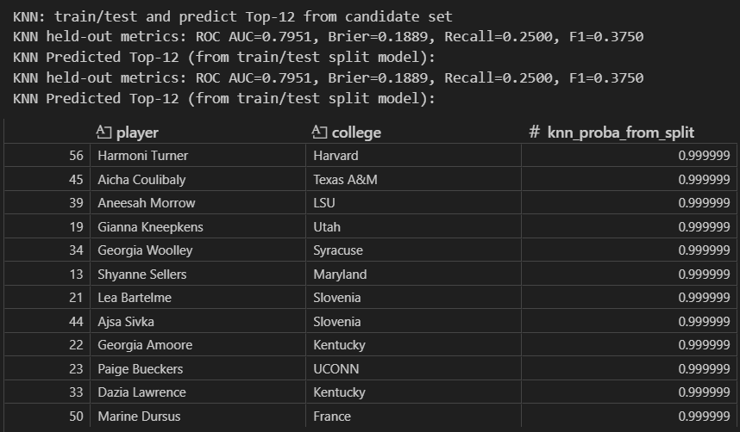
Other Model Evaluations
KNN Model
Logistic Regression Model
SVC Model
Gradient Boosting Model
MLP Model
GaussianNB Model
Linear Discriminant Analysis Model
Quadratic Discriminant Analysis Model
Decision Tree Model

Slide 11
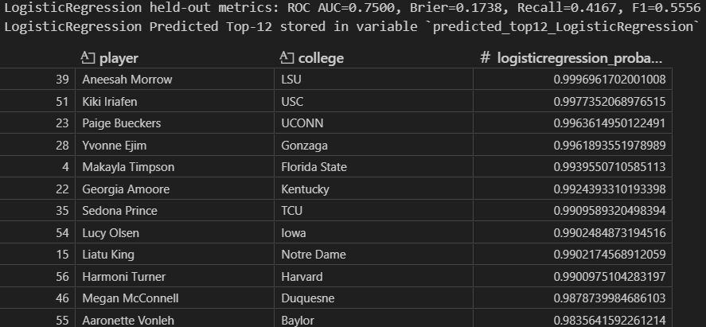
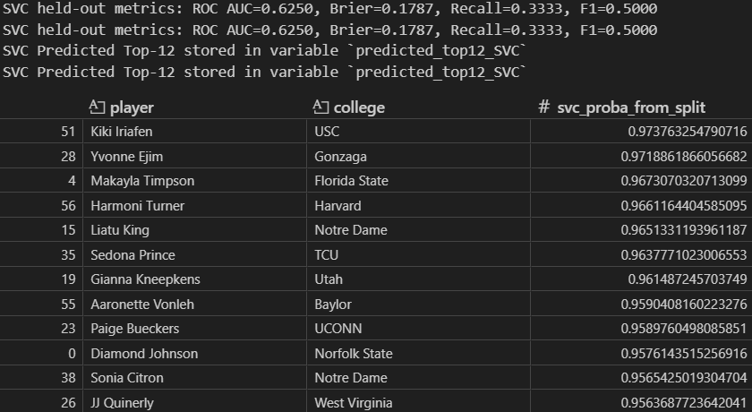
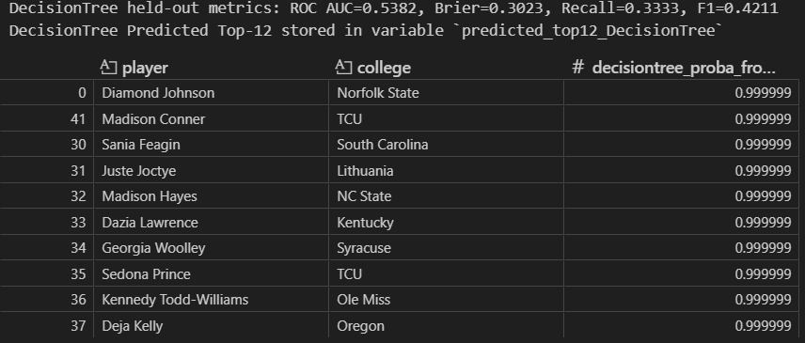
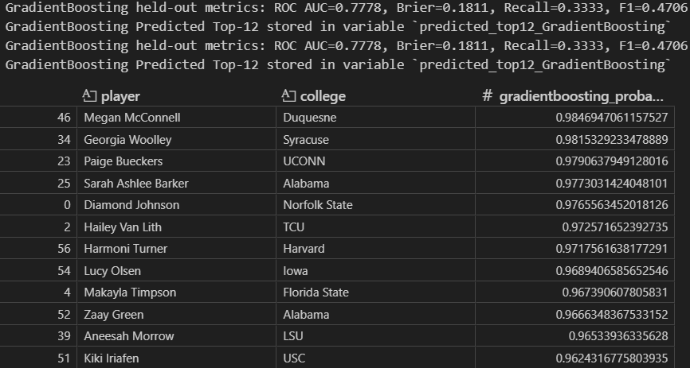
Other Model Evaluations

Slide 12
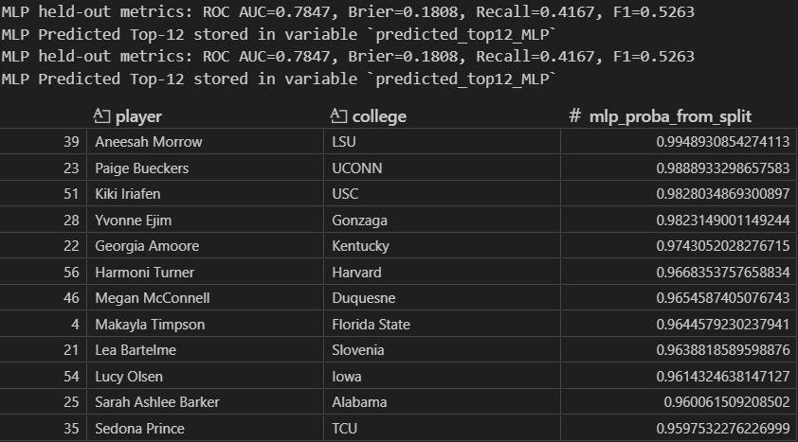
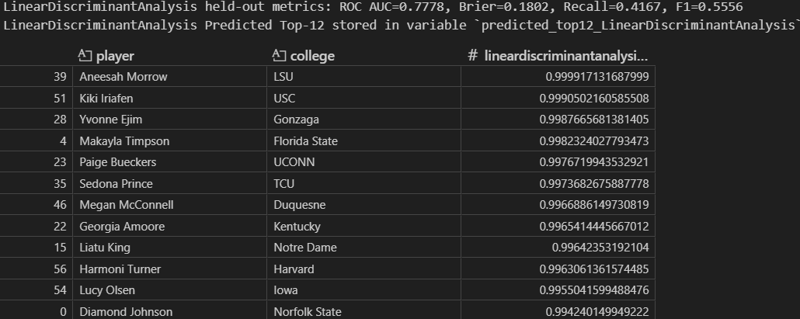
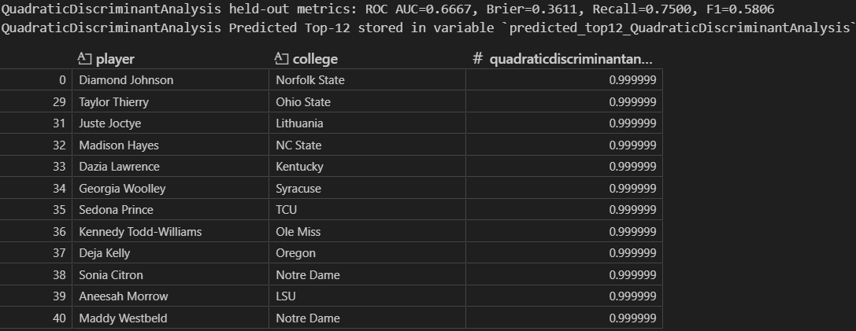
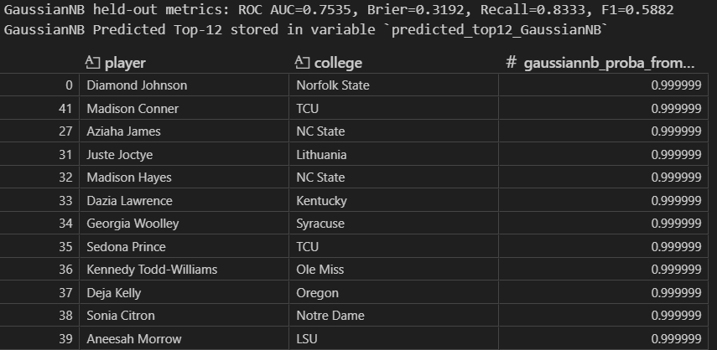
Other Model Evaluations

Slide 13
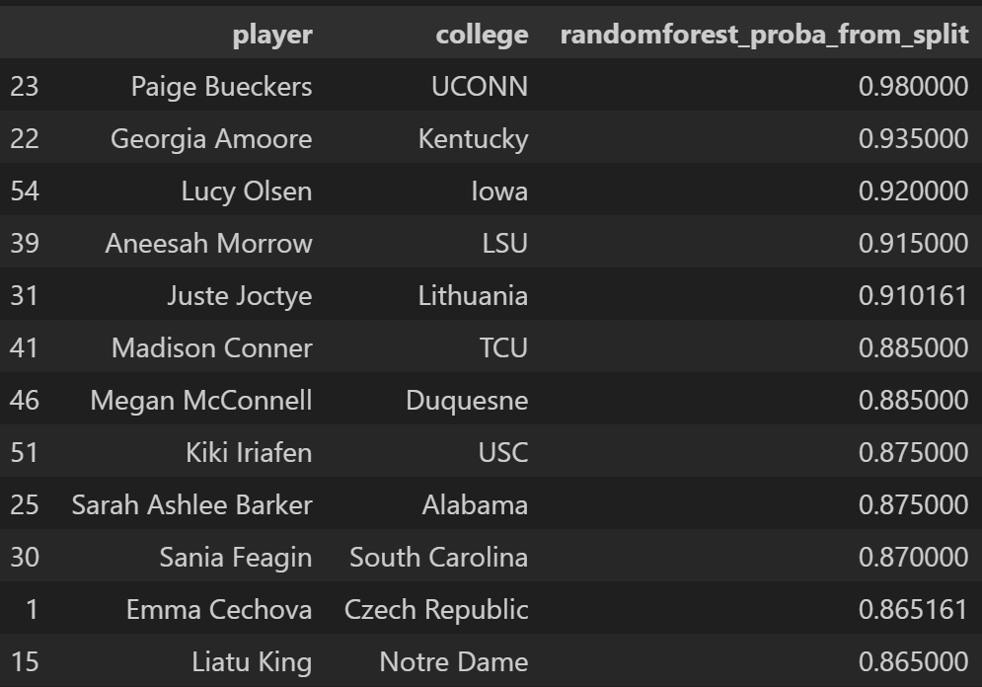
Final List (random forest model)
We chose Random Forest because it produced the best cross-validation among the candidates
Random Forest reduces overfitting giving it a more stable performance against different splits
It handled our categorical columns and our numerical features without heavily inducing transformations
It provided the best feature-importance scores

Slide 14
Comparison of each Player
Paige Bueckers
Georgia Amoore
Lucy Olsen
Aneesah Morrow
Juste Jocyte
Megan McConnell
Madison Conner
Kiki Iriafen
Sarah Ashlee Barker
Sania Feagin
Emma Cechova
Serena Sundell

Slide 15
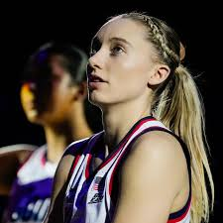
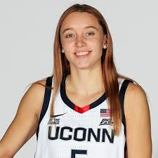
Paige Bueckers
Our Prediction: #1 Pick
Real Draft: #1 Pick
College: UCONN
Pros: Great offensive player (19.8 PPG) & (53.4 FG%)
and went to the top WBB school (UCONN)
Cons: Age/Past Injury History (23 yrs.)
Team that had the Pick: Dallas Wings
Non-Stat Reasons: Only freshman in WBB history to
win National Player of the Year and one of the biggest names in WBB

Slide 16
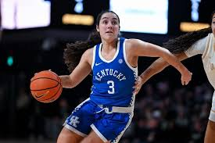
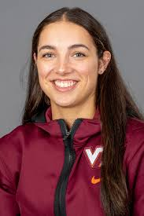
Georgia Amoore
Our Prediction: #2 Pick
Real Draft: #6 Pick
College: Kentucky
Pro: High basketball IQ (5.5 APG) and dynamic offense (15.7 PPG)
Con: Low height (5’6)
Team that had the Pick: Seattle Storm
Actual Pick: Dominique Malonga
Non-Stat Reasons: Seattle needed a big and Malonga is 6’7, Seattle has the oldest players and Malonga is only 19

Slide 17
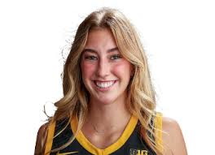
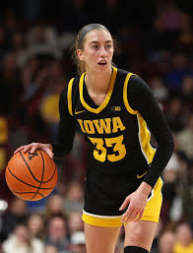
Lucy olsen
Our Prediction: #3 Pick
Real Draft: #23 Pick
Actual Pick: Sonia Citron
College: Iowa
Pros: Strong midrange game (43.6 FG%) and great court vision (5.1 assists)
Cons: High turnover rate (3.1)
Team that had the Pick: Washington Mystics
Non-Stat Reasons: Transferred her last year to Iowa from Villanova (low ranked team), Iowa fell short of NCAA tournament expectations, and Mystics needed a 3-point shooter (Sonia Citron)

Slide 18
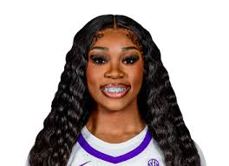
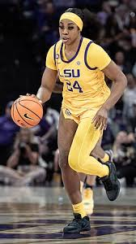
Aneesah morrow
Our Prediction: #4 Pick
Real Draft: #7 Pick
Actual Pick: Kiki Iriafen
College: LSU
Pros: Double-Double machine (20.6 PPG, 12.4 RPG)
Cons Below average height for her position (6’1) and low 3-FG% (37.20%)
Team that had the Pick: Washington Mystics
Non-Stat Reasons: Mystics needed a taller forward and a better 3-point shooter

Slide 19
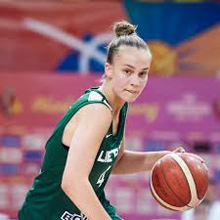
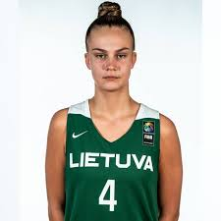
Juste joctye
Our Prediction: #5 Pick
Real Draft: #5 Pick
Former: Lithuania
Pros: Smooth shooting (17 PPG, 42.9 FG%)
Cons: Small sample size cause of international play (4 games)
Team that had the Pick: Golden State Valkyries
Non-Stat Reasons: Golden State was an expansion team, so they wanted a young player (20 yrs), they also had many international players on their roster

Slide 20
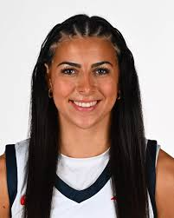
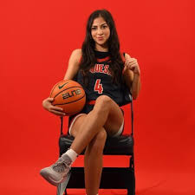
Megan mcConnell
Our Prediction: #6 Pick
Real Draft: NOT DRAFTED
Actual Pick: Georgia Amoore
College: Duquesne
Pros: Great overall player (18.4 PPG, 5 APG, and 7.2 RPG)
Cons: Went to a mid major school (Duquesne)
Team that had the Pick: Washington Mystics
Non-Stat Reasons: Had great stats but just didn’t get national attention

Slide 21
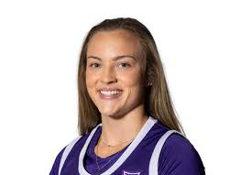
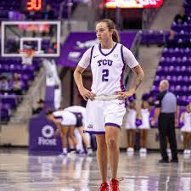
Madison conner
Our Prediction: #7 Pick
Real Draft: #29 Pick
Actual Pick: Aneesah Morrow
College: TCU
Pros: Good shooting abilities (44.6 FG% and 44.9 3-FG%)
Cons: Wasn’t the star of her team (10.6 PPG and 2.7 RPG)
Team that had the Pick: Connecticut Sun
Non-Stat Reasons: The Mystics needed a true point guard and Conner is a shooting guard

Slide 22
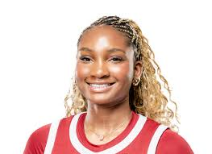
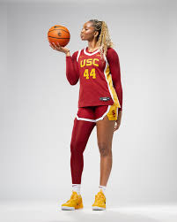
Kiki iriafen
Our Prediction: #8 Pick
Real Draft: #4 Pick
Actual Pick: Saniya Rivers
College: USC
Pros: Strong rebounding and scoring ability (18.0 PPG and 8.4 RPG)
Cons: A defensive liability against taller forwards/centers (6’3)
Team that had the Pick: Connecticut Suns
Non-Stat Reasons: Transferred from Stanford where she didn’t get much minutes to USC where she was a starter and playing upward 20 minutes a game

Slide 23
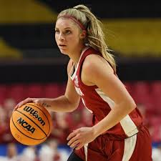
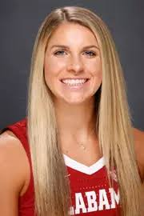
Sarah ashlee barker
Our Prediction: #9 Pick
Real Draft: #9 Pick
College: Alabama
Pros: Strong scoring ability (18.2 PPG)
Cons: High turnover rate (3.3)
Team that had the Pick: Los Angeles Sparks
Non-Stat Reasons: Wasn’t on any national level but had a breakout performance during the sweet sixteen where she scored 45 points

Slide 24
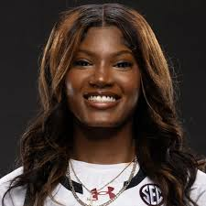
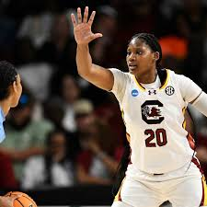
Sania feagin
Our Prediction: 10 Pick
Real Draft: #21 Pick
Actual Pick: Ajsa Sivka
College: South Carolina
Pros: Strong shot-making ability (60.1 FG%)
Cons: Smaller big (6’3), low minutes (19.8)
Team that had the Pick: Chicago Sky
Non-Stat Reasons: Is a 2x National Champion, Chicago needed a guard already have 2 strong bigs

Slide 25
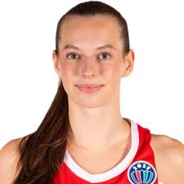
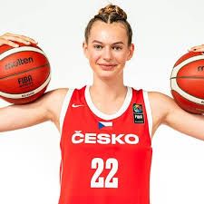
Emma cechova
Our Prediction: #11 Pick
Real Draft: NOT DRAFTED
Actual Pick: Hailey Van Lith
Former: Czech Republic
Pros: Strong shot making abilities (58.50 FG%)
Cons: Small sample size (6 games)
Team that had the Pick: Chicago Sky
Non-Stat Reasons: Hard to know haw an international players skills will transfer over

Slide 26
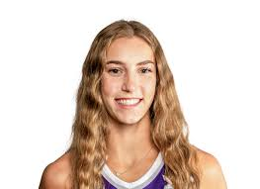
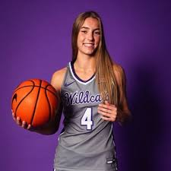
Serena Sundell
Our Prediction: #12 Pick
Real Draft: #28 Pick
Actual Pick: Aziaha James
College: Kansas State
Pros: Strong assist numbers (7.3 APG), high FG% (50.10 FG%)
Cons: Above average turnovers (2.9), Not a great 3-point shooter (32.oo% 3-FG%)
Team that had the Pick: Dallas Wings
Non-Stat Reasons: Her team did underperform in the NCAA tournament, but she was the NCAA leading assist leader

Slide 27
Complications/Resolutions
Complication:
We kept getting different lists when we ran the final model
Resolution:
We didn’t have a set seed but once we set it, we got the same lists
Complication:
We weren’t getting any final lists we liked
Resolution:
We added more data to make the stats on each player more clear

Slide 28
THANK YOU
Andriana Slisko
Gabriella Vallar
Emmanuela Fleurant

